Slide 1



HCP Journey Workshop 4
Tuesday 20th April

Slide 2
Objectives
Recap the Adoption Ladder and HCP Journey principles/progress
Get set-up with Custellence
Review new HCP Journey Template (in Custellence)
Iterate and confirm Custellence template layout
Define HCP Journey entry points

Slide 3
Recap

Slide 4
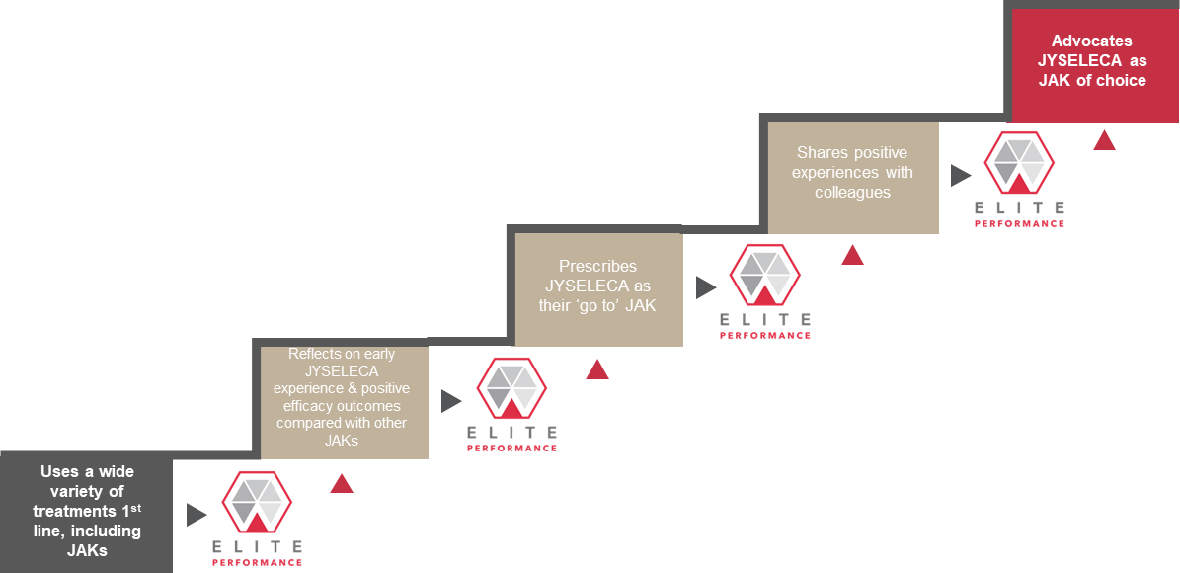
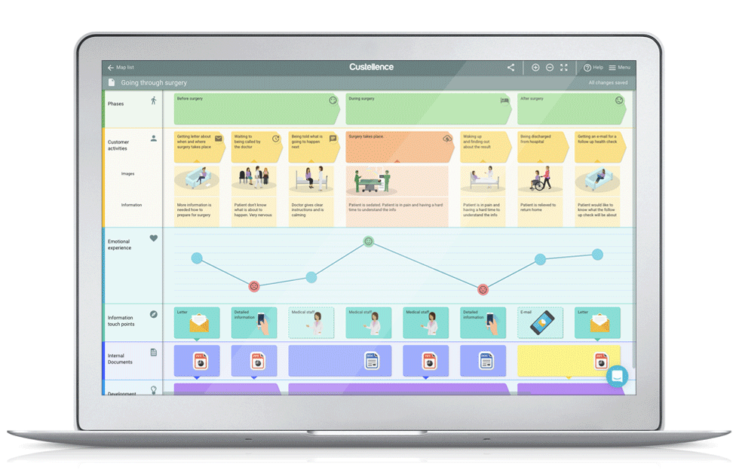
Adoption Ladder
HCP Journeys
The HCP-focused mapping of the level of product adoption.
The execution-focused mapping of the touchpoints with an HCP.
Adoption Ladder + HCP Journey = ???

Slide 5



Behaviour Change
CURRENT
Uses a very broad spectrum of products including JAKs
Uses very recently launched products
Able to talk extensively about new and pipeline treatments
Willing to act ahead of guidelines
DESIRED
Tries JYSELECA with some patients
(After they have gained experience) Expand JYSELECA use in a wider range of patients in preference to other JAKs
Unmet Need
Research
1st Rx
Prescribes
Advocates
Adoption Stage
#1
#2
#3
#4
#5
High-Level Goal
To demonstrate that despite new treatments, unmet needs still remain, especially related to a balance of efficacy and safety
Segmented Goals
Mavericks: Uses a wide variety of treatments 1st line, including JAKs
Pragmatists: Occasionally uses JAKs but not consistently [high variation within segment – some are very high JAK users]
Compassionates: Uses a variety of products based on patient need & guideline recommendations
High-Level Goal
To ensure early positive experiences as proof of concept (and to share with peers)
Segmented Goals
Mavericks: Reflects on early JYSELECA experience & positive efficacy outcomes compared with other JAKs
Pragmatists: Attends a peer-to peer discussion with local colleagues about their experiences with JYSELECA & its safety profile
Compassionates: Attends a discussion with local expert about their experiences with JYSELECA & its safety profile
High-Level Goal
To differentiate JYSELECA versus other JAKs, especially RINVOQ
Segmented Goals
Mavericks: Prescribes JYSELECA as their ‘go to’ JAK
Pragmatists: Prescribes JYSELECA for some patients where safety is the main concern
Compassionates: Prescribes JYSELECA for some patients where safety & simplicity are important
High-Level Goal
To create an environment that facilitates exchange of positive experiences
Segmented Goals
Mavericks: Shares positive experiences with colleagues
Pragmatists: Gains depth of experience in patients where safety is a concern
Compassionates: Monitors feedback & safety signals in JYSELECA patients
High-Level Goal
To identify, support, and create a platform for JYSELECA advocates
Segmented Goals
Mavericks: Advocates JYSELECA as JAK of choice
Pragmatists: Expands the use of JYSELECA to different types of patients so ultimately JYSELECA becomes JAK of choice
Compassionates: Starts to use JYSELECA as first line JAK inhibitor
Galapagos Goal
Currently Unsegmented Barriers
Satisfied with current options
Complacency/habit
Don’t believe there are significant unmet needs that can be addressed by (another) JAK
Believe another MOA will be needed to address unmet needs
Communication gap between patients and HCPs that masks unmet needs/treatment gaps (especially Compassionates)
CoVid context : access challenge to care
Highly competitive environment with comparisons between treatments hard to make.
Treatment inertia and need to overcome mindset shift
Currently Unsegmented Barriers
Awareness & Access
Access to JYSELECA
Lack of access to sampling
Lack of experience with JYSELECA
Lack of familiarity with Galapagos and new relationship with reps
Differentiation
Perceived lack of differentiation from RINVOQ
Sees no difference in clinic relative to RINVOQ
Negative Safety Halo
Residual JAK concerns from 1st generation
Clinical
Has a negative experience in a patient in first few patients
Lack of clarity of who the ideal JYSELECA patient is
Currently Unsegmented Barriers
Satisfaction with their current JAK and no reason to change
Prefer to have a wide armamentarium, rather than a go-to
Like to keep options open as new entries emerge
Competitive messaging and share of voice
Uncertainty around available JYSELELCA support services for HCPs and patients
Unsure of which patient population to expand usage in
Currently Unsegmented Barriers
Negative experiences that temper their enthusiasm
Wanting to appear unbiased/unaligned with a brand
Currently Unsegmented Barriers
Do not have a JAK of choice and philosophically opposed to aligning with one product
Don’t have a platform from which to advocate
Barriers
Summary of RA Workshop Discussion (1 of 2)

Slide 6
Behaviour Change
CURRENT
Uses a very broad spectrum of products including JAKs
Uses very recently launched products
Able to talk extensively about new and pipeline treatments
Willing to act ahead of guidelines
DESIRED
Tries JYSELECA with some patients
(After they have gained experience) Expand JYSELECA use in a wider range of patients in preference to other JAKs
Unmet Need
Research
1st Rx
Prescribes
Advocates
Adoption Stage
#1
#2
#3
#4
#5
Message Objective by Segment:
Mavericks: significant need for new treatment options – they already agree with this and are keen to try new options, esp if efficacy is not compromised
Pragmatists: need for more safe treatment options that do not compromise on efficacy
Compassionates: focus on unmet needs from a patient perspective – less from an HCP perspective
Message Topics:
Unmet needs messaging : 1/3 patients are refractory, EULAR guidelines, (5messages in total)
FAQ on CoVid impact
Message Objective by Segment:
Mavericks: expose to full data esp efficacy, give opportunity to try – make it easy, but they will be interested
Pragmatists: expose to full data incl safety, ref trusted peers/colleagues and hands on experience
Compassionates: KOL/Peer/trusted source perspectives on JYS safety and simplicity – ‘permission to try’
Message Topics
Now available
MoA : selectivity (vs 1G)
Comprehensive clinical evidence : 3 CT and long term data
Strength of balance story : full strength with safety)
Reimbursement : (to be localised)
Patient identification
HCP and Patient Support Service (Cpst) / to be localised)
Message Objective by Segment:
Mavericks: reinforce experience, share additional data freely, seed need to share with others
Pragmatists: advocate trial and follow up re experience and expansion of trial use
Compassionates: share/encourage patient feedback, patient perspectives, PIO
Message Topics
Efficacy
Safety
Patient Profiles
Patient identification
Corporate support
HCP and Patient Support Service
Message Objective by Segment:
Mavericks: provide opportunities to share experience and discuss with others
Pragmatists: expand patient types as experience is gained – give different ‘pegs
Compassionates: Monitors feedback & safety signals in JYSELECA patients
Message Topics
Efficacy
Safety
Patient Profiles
Patient identification
Corporate support
HCP and Patient Support Service
Message Objective by Segment:
Mavericks: KOL opportunities – keeping in mind loyalty can prob not be expected
Pragmatists: consolidate experience to lead to JAK of choice ‘peg’]
Compassionates: consolidate experience and ptn feedback to lead to JAK of choice ‘peg’ and 1L use
Message Topics
Corporate support
HCP and Patient Support Service
Partnership opportunities
Messages
Message Source
Detail Aid…
Implementation Guide
LearnJAKStat
Published literature (cost of lack of ttt)
FAQ
TeachJAKStat
MyMentum drop material
Detail Aid…
Finch video
Available publications
(refer to channel preference to maximize interactions by segments)
HCP Portal (pending country site map)
- To be Discussed
- To be Discussed
- To be Discussed
Summary of Workshop Discussion (2 of 2)

Slide 7
Journey Principles
What is the priority?
Practical / Pragmatic
Reflect brand plan and prioritization of activation
Simple
Addressing customer needs and preferences – leveraging market research (content, channel, style, time)
Actionable today = channel maturity, content is there, or where consent is required
Powered by Insight & data (try to combine where possible to see 360 view)
‘Aligned to CRM/CDP’
Various access points (into journey)
Linked to key events
Journeys are connected and not in isolation
Leverages digital and physical touchpoints
Based on fact, not feeling (where possible)

Slide 8



Tool Comparison
Easily Editable – Basic Changes
Easily Editable – Structural Changes
Learning Curve
Live Collaboration
Flexibility
Readability
Full map visualisation
Guided Journey Creation
Cost

Slide 9
Custellence
After comparing a multitude of tools, we believe Custellence has the best balance of features vs simplicity, with simplicity being key.
No journey mapping tools discovered have simple integrations with CRM
All tools allow for exporting the journeys, however exporting in aspect ratio suitable for PPT always requires some finesse.
Other tools have more functionality, or more customisation, but at a simplicity cost that is too significant.

Slide 10
HCP Journeys Creation 2

Slide 11
Objectives
Review the latest template updates
Define HCP Journey entry points
Iterate and confirm Custellence template layout – including the number and types of ‘scenarios’
Start building the initial journeys!

Slide 12
Template Updates

Slide 13


Explore the Template
5 mins

Slide 14
Rep-Driven - Consent | Rep Driven – No Consent | Digital - Only | HCP - Driven
 |  | Online advert
 |  | CME
 |  | Print Advert

Slide 15
# of Touchpoints
Less touchpoints, more scenario variants?
Less variants, more touchpoints?

Slide 16
Actions
…
…

Slide 17
Scenarios Types?
Rep-Driven: with Consent
Rep-Driven: No Consent
HCP-driven :
“I want to understand the difference among JAKS”
“I click on a banner”
“I respond to a mass email” (UK)
Sample request
Subscription to newsletter
Above-country driven : with entry points to local journeys.
EULAR, pre/ post event i.e Medscape campaign (show an illustrative example, a blueprint for the future)
Product Webinar (Q3)
Physician is new to Galapagos
Assumption is :
- reps are there
with consent
Not a place for a digital only journey
Service in preparation : possibility to schedule a call wirth MSL

